Slide 1
Lecture 1-2
CSE202: OBJECT ORIENTED PROGRAMMING

Slide 2
Lecture 1-2: Outline
Concepts and Basics of C++ Programming
  Introduction
  What is Procedure Oriented Programming (POP)?
  What is Object Oriented Programming (OOP)?
Differences between procedural and object oriented programming
Features of Input/output Streams
  Basic Input/Output in C++
  Stream class hierarchy
Reading and writing data using cin and cout
Structure of C++ program

Slide 3
Concepts and Basics of C++ Programming

Slide 4
Introduction
C++ is an object oriented programming (OOP) language developed by Bjarne Stroustrup.
Stroustrup began developing C++ in 1979 (then called “C with classes”), and, in his own words, invented C++, wrote its early definitions, and produced its first implementation… choose and formulated the design criteria for C++ , designed all its major facilities.
In 1983, “C with Classes” was renamed to “C++” (++ being the increment operator in C), adding new features.
First commercial release of the C++ language was in 1985.

Slide 5
What is Procedure Oriented Programming (POP)?
Procedure Oriented Programming language is a list of instruction where each statement tells the computer to do something.
It focuses on procedure (function) & algorithm is needed to perform the derived computation.
When program become larger, it is divided into function & each function has clearly defined purpose.
Dividing the program into functions & module is one of the cornerstones of structured programming.
E.g.:- c, basic, FORTRAN.

Slide 6
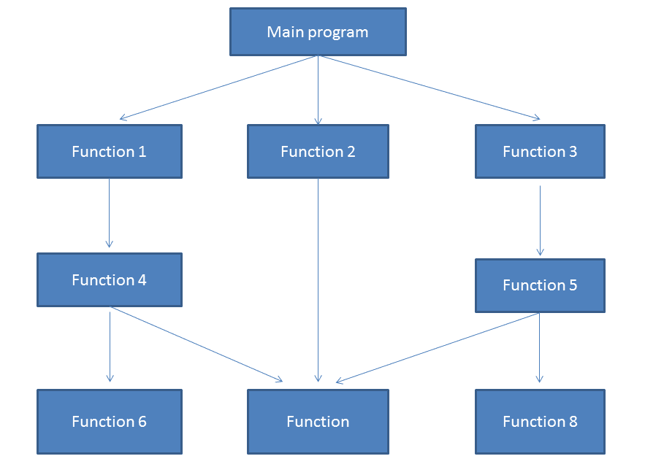
Structure of Procedural Oriented Programming

Slide 7
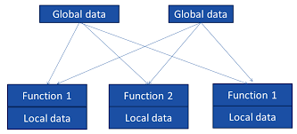
Relationships of data and function in Procedural Programming

Slide 8
What is Object Oriented Programming (OOP)?
The major motivating factor in the invention of object oriented approach is to remove some of the flaws encountered in the procedural approach.
OOP treats data as a critical element in the program development and does not allow it to flow freely around the system. It ties data more closely to the functions that operate on it, and protects it from accidental modification from outside functions.
OOP allows decomposition of a problem into a number of entities called objects and then builds data and functions around these objects.

Slide 9
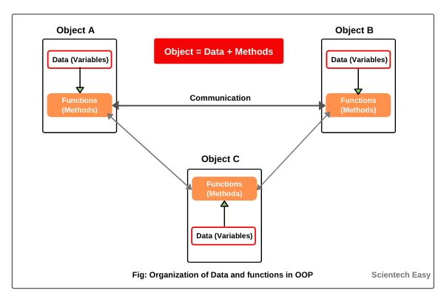
Organization of data and function in OOP

Slide 10
Differences between procedural and object oriented programming

Slide 11
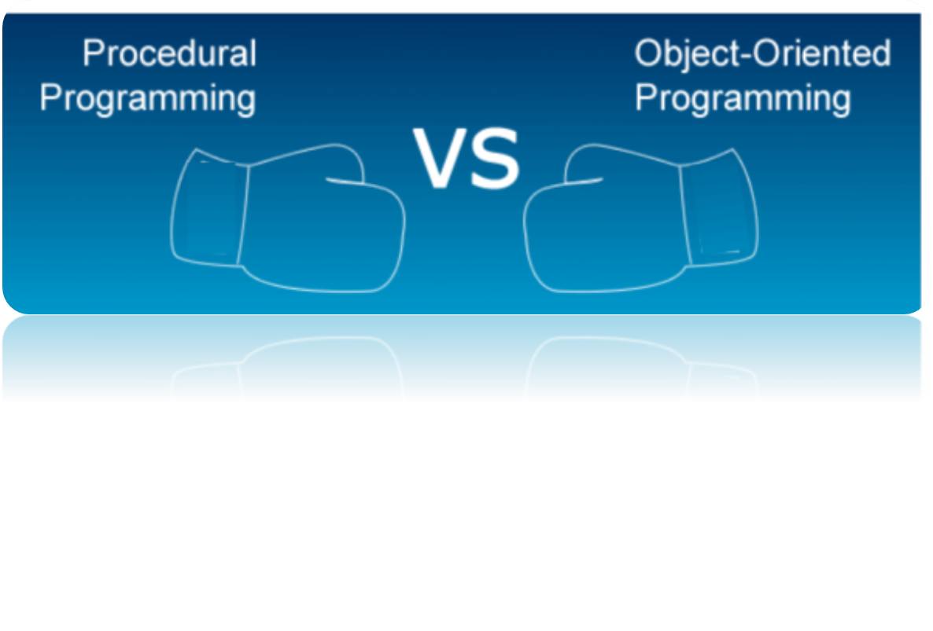
Differences between procedural and object oriented programming
However, to become proficient in the C ++ programming language, one must first understand the fundamental differences between procedural and object-oriented programming paradigms.

Slide 12
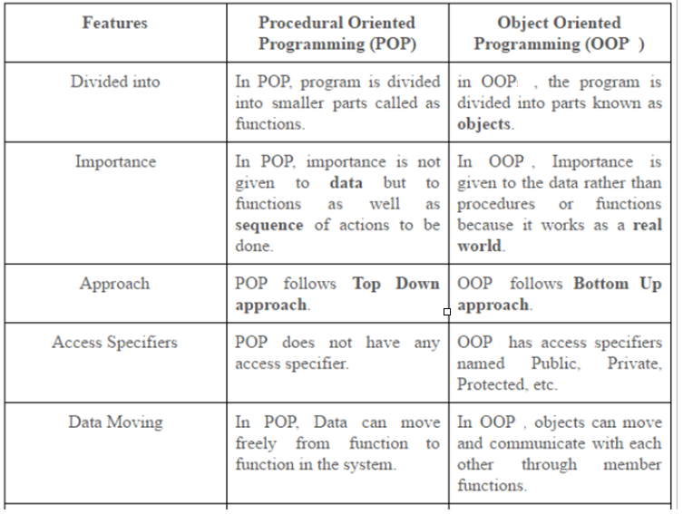
Differences between procedural and object oriented programming

Slide 13
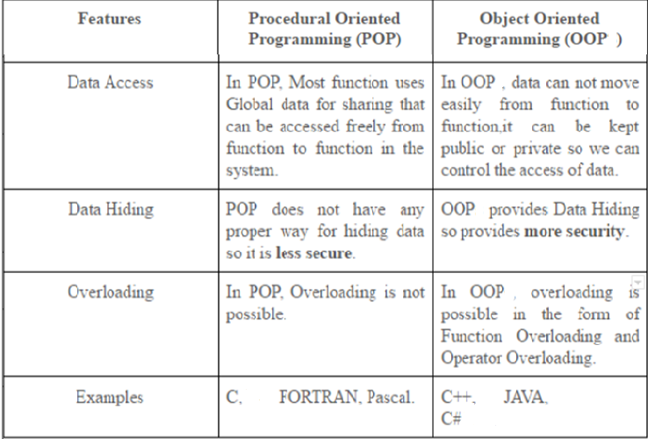
Differences between procedural and object oriented programming

Slide 14
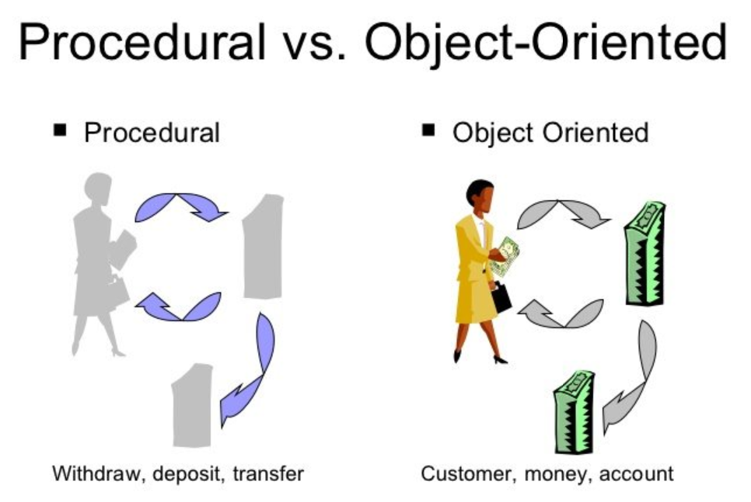
Differences between procedural and object oriented programming

Slide 15
MCQ
Which programming paradigm focuses on breaking down a problem into a series of procedures or functions?
a) Object-Oriented Programming (OOP)
b) Procedure-Oriented Programming (POP)
c) Functional Programming (FP)
d) Event-Driven Programming (EDP)

Slide 16
Solution
Which programming paradigm focuses on breaking down a problem into a series of procedures or functions?
a) Object-Oriented Programming (OOP)
b) Procedure-Oriented Programming (POP)
c) Functional Programming (FP)
d) Event-Driven Programming (EDP)

Slide 17
Features of Input/output Streams

Slide 18
Features of Input/Output Streams
C++ comes with libraries that provide us with many ways for performing input and output.
In C++ input and output are performed in the form of a sequence of bytes or more commonly known as streams. There two types of stream in C++.
  Input Stream: If the direction of flow of bytes is from the device(for example, Keyboard) to the main memory then this process is called input.
  Output Stream: If the direction of flow of bytes is opposite, i.e. from main memory to device( display screen ) then this process is called output.

Slide 19
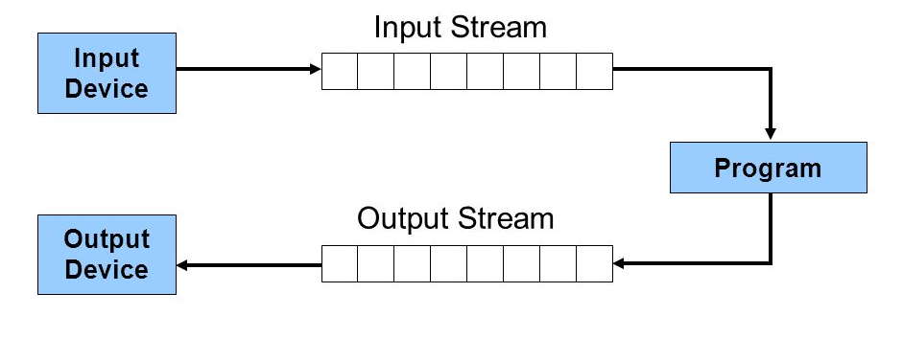
Basic Input/Output in C++

Slide 20
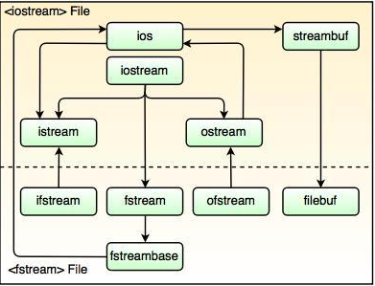
Stream class hierarchy

Slide 21
Stream class hierarchy
In the above figure, ios is the base class. The iostream class is derived from istream and ostream classes.
The ifstream and ofstream are derived from istream and ostream, respectively. These classes handles input and output with the disk files.The fstream.h header file contains a declaration of ifstream, ofstream and fstream classes.
The iostream.h file contains istream, ostream and iostream classes and included in the program while doing disk I/O operations. The filebuf class contains input and output operations with files.
The streambuf class does not organize streams for input and output operations, only derived classes of streambuf performs I/O operations.
These derived classes arranges a space for keeping input data and for sending output data.The istream and ostream invokes the filebuf functions to perform the insertion or extraction on the streams.

Slide 22
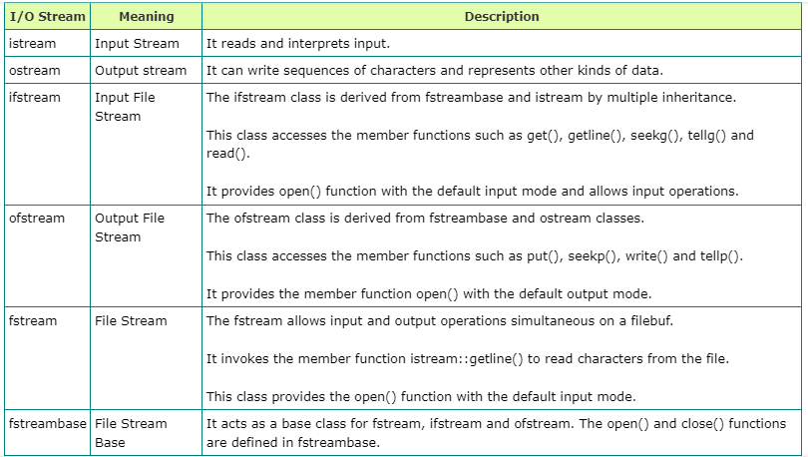
Stream class hierarchy

Slide 23
Header files available in C++ for Input – Output operation are:
iostream: iostream stands for standard input output stream. This header file contains definitions to objects like cin, cout, cerr etc.
iomanip: iomanip stands for input output manipulators. The methods declared in this files are used for manipulating streams. This file contains definitions of setw, setprecision etc.
fstream: This header file mainly describes the file stream. This header file is used to handle the data being read from a file as input or data being written into the file as output.

Slide 24
Stream Objects
The standard C++ library defines the following stream objects to access the standard sources and destinations of characters during program execution.
Cin: Standard input stream(usually the keyboard)
Cout: Standard output stream(usually the screen)
Cerr: Standard error stream, it is the same as the output stream.
Clog: Standard logging stream, it is the same as the output stream.

Slide 25
Reading and writing data using cin and cout

Slide 26
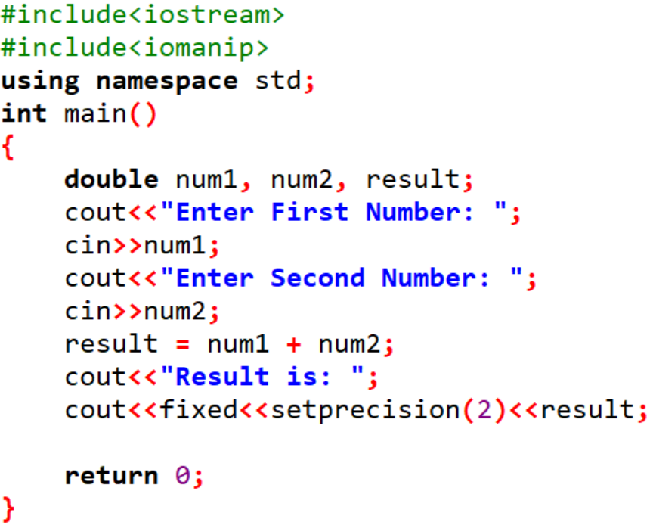


Slide 27
Cout
cout is used for the output of data of various types. This has been made possible by overloading the operator<<(insertion operator) in the ostream class to recognize all the basic c++ types.
eg. cout<<“Hello”;
cout will display this string as such on screen.
eg. cout<< a;
if “a’ is variable then cout can be used to display the contents of “a”.

Slide 28

Example 1: To print the numbers and character variables
#include<iostream>
using namespace std;
int main()
{
int num1=70;
double num2=256.783;
char ch='A';
cout<<num1<<endl;
cout<<num2<<endl;
cout<<"character:"<<ch<<endl;
}
Output:
Note:
The endl manipulator is used to insert a new line. That's why each output is displayed in a new line.

Slide 29
Cin
Cin is used for the input of data of various types. This has been made possible by overloading the operators >>(extraction) in the istream class to recognize all the basic c++ types.
The following is the general format for reading data from the keyboard:
eg: int a,b;
cin>>a>>b;
.

Slide 30

Example 2: Enter and Display Integer Value
#include<iostream>
using namespace std;
int main()
{
int num;
cout<<"Enter an integer:";
cin>>num;//Taking input
cout<<"The number is:"<<num;
}
Output:
Note: If we don't include the using namespace std; statement, we need to use std::cin instead of cin .

Slide 31
Cascading of Input/Output Operators
We can use the << operator multiple times in the same line. This is called cascading. For example,
Cout<<“\n”<<“First Name=“<<“Jian”;
Similar to cout, cin can also be cascaded, for example,
Cin>>marks_cprog>>marks_python;

Slide 32
MCQ 1
The operator used with cout is called:
a. Insertion operator
b. Extraction operator
c. Get operator
d. Comparison operator

Slide 33
Solution
The operator used with cout is called:
a. Insertion operator
b. Extraction operator
c. Get operator
d. Comparison operator

Slide 34
MCQ 2
The operator used with cin is called:
a. Insertion operator
b. Extraction operator
c. Get operator
d. Comparison operator

Slide 35
Solution
The operator used with cin is called:
a. Insertion operator
b. Extraction operator
c. Get operator
d. Comparison operator

Slide 36
MCQ 3
In CPP, cin and cout are the predefined stream __________ .
a. Operator
b. Functions
c. Objects
d. Data types

Slide 37
Solution
In CPP, cin and cout are the predefined stream __________ .
a. Operator
b. Functions
c. Objects
d. Data types

Slide 38
MCQ 4
Classes in CPP are________ .
a. derived data types
b. User defined data types
c. built-in data types
d. All of these

Slide 39
Solution
Classes in CPP are________ .
a. derived data types
b. User defined data types
c. built-in data types
d. All of these

Slide 40
MCQ 5
The file iostream includes
The streams of includes and outputs of program effect.
The declarations of the basic standard input-output library.
both a and b
none of these

Slide 41
Solution
The file iostream includes
The streams of includes and outputs of program effect.
The declarations of the basic standard input-output library.
both a and b
none of these

Slide 42
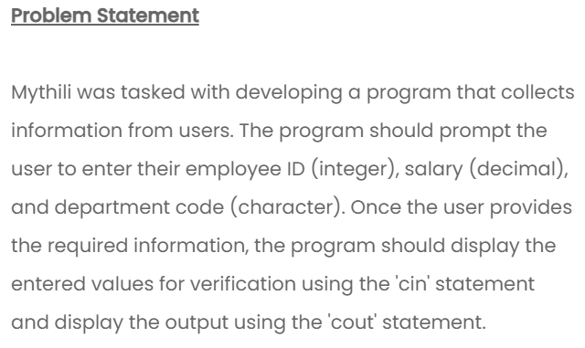

Slide 43
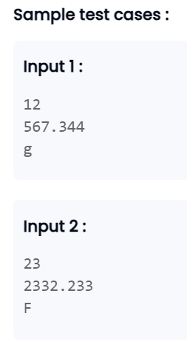
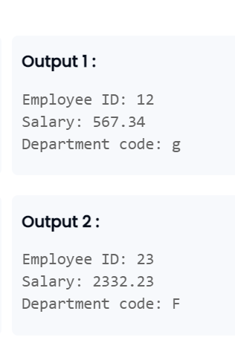

Slide 44
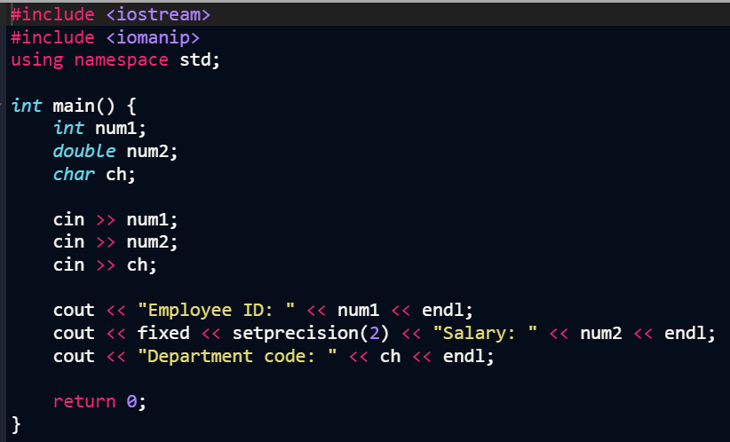

Slide 45


Slide 46
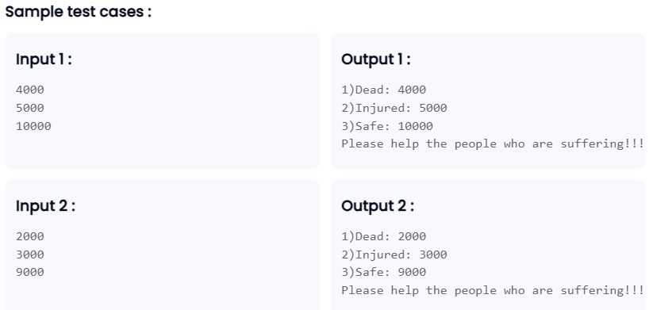

Slide 47
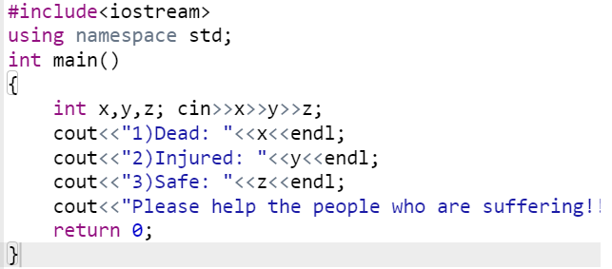

Slide 48


Slide 49
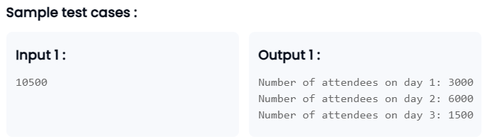

Slide 50
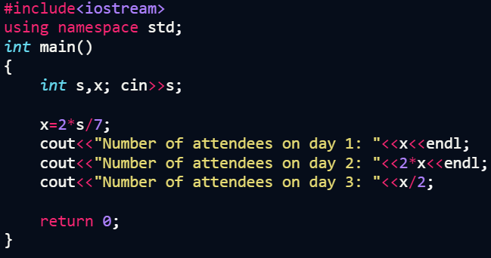

Slide 51
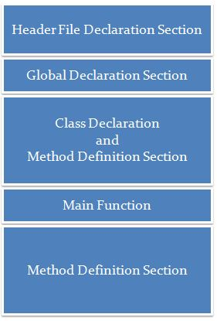
Structure of C++ Program

Slide 52
Structure of C++ Program
Section 1 : Header File
The header files contain the definition of the functions and macros we are using in our program. They are defined on the top of the C++ program.
In line #1, we used the #include <iostream> statement to tell the compiler to include an iostream header file library which stores the definition of the cin and cout methods that we have used for input and output. #include is a preprocessor directive using which we import header files.
Syntax:
#include <library_name>

Slide 53
Structure of C++ Program
Section 2 : Global Declaration Section
Global Variables are declared here.
Global Declaration may include –
  Declaring Structure
  Declaring Class
  Declaring Variable
Section 3 : Class Declaration Section
Actually this section can be considered as sub section for the global declaration section.
Class declaration and all methods of that class are defined here.

Slide 54
Structure of C++ Program
Section 4 : Main Function
Each and every C++ program always starts with main function.
This is entry point for all the function. Each and every method is called indirectly through main.
We can create class objects in the main.
Operating system call this function automatically.
Section 5 : Method Definition Section
This is optional section . Generally this method was used in C Programming.

Slide 55

Program 1
// Program to add two numbers
#include <iostream>
using namespace std;
int main() {
int num1; //to store first number
int num2; //to store second number
int add; //to store addition
cout<<"Enter first number: ";
cin>>num1;
cout<<"Enter second number: ";
cin>>num2;
add=num1+num2;
cout<<"Addition is: "<<add<<endl;
return 0;
}
Output:

Slide 56
Using namespace std
A namespace is designed to overcome this difficulty and is used as additional information to differentiate similar functions, classes, variables etc. with the same name available in different libraries. Using namespace, you can define the context in which names are defined. In essence, a namespace defines a scope.
Therefore, Namespace collects identifiers used for class, object and variables. NameSpace can be used by two ways in a program, either by the use of using statement at the beginning, like we did in above mentioned program or by using name of namespace as prefix before the identifier with scope resolution (::) operator.
Examples:
Using namespace std;
cout<<“A”;
std::cout << "A";

Slide 57
C++ practicing examples
Program to Find Largest Number Among Three Numbers
Program to Calculate Sum of Natural Numbers
Program to Check Whether a Number is Prime or Not
Program to Display Fibonacci Series

Slide 58
Lecture 3
CSE202: OBJECT ORIENTED PROGRAMMING

Slide 59
Lecture 3: Outline
Creating classes
Class objects
Accessing class members

Slide 60
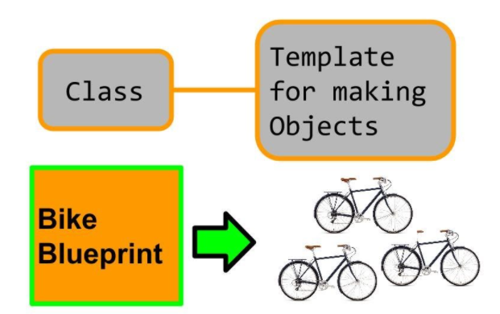
Class and objects
In C++, rather than creating separate variables and functions, we can also wrap these related data and functions in a single place (by creating objects).
This programming paradigm is known as object-oriented programming. But before we can create objects and use them in C++, we first need to learn about classes.

Slide 61
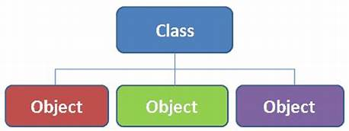
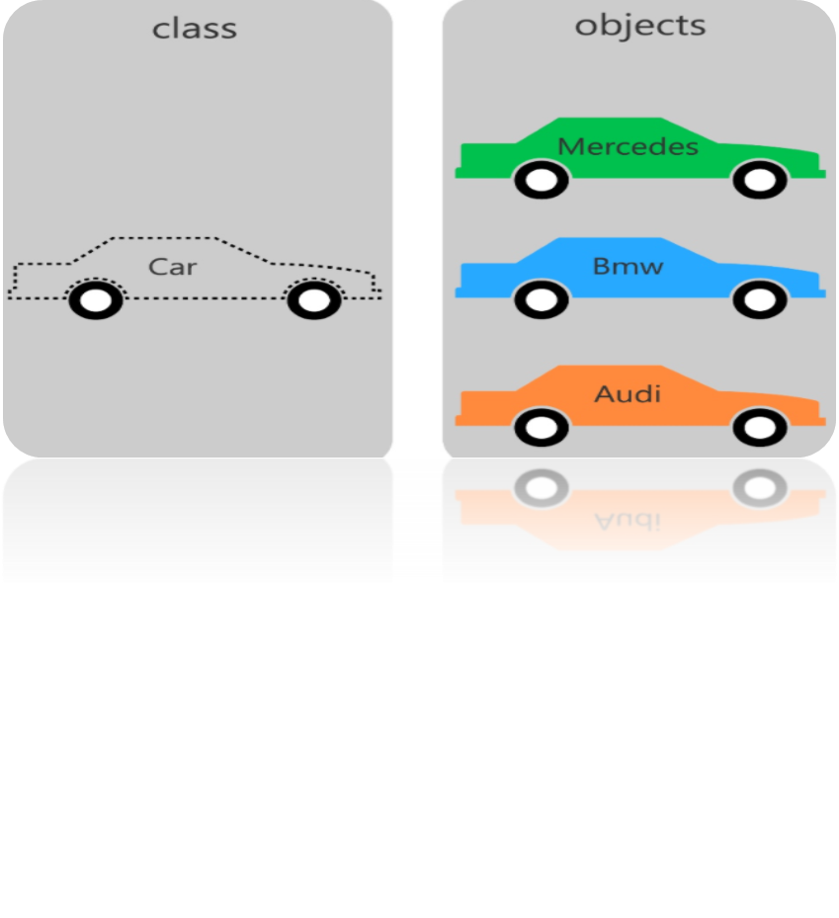
Class and objects

Slide 62
Class
A class is a blueprint for the object. We can think of a class as a sketch (prototype) of a house. It contains all the details about the floors, doors, windows, etc. Based on these descriptions we build the house. House is the object.
A class in C++ is the building block, that leads to Object-Oriented programming. It is a user-defined data type, which holds its own data members and member functions, which can be accessed and used by creating an instance of that class..
For Example: Consider the Class of Cars. There may be many cars with different names and brand but all of them will share some common properties like all of them will have 4 wheels, Speed Limit, cost etc.

Slide 63
Class specification
Generally, a class specification has two parts:
1. Class declaration
2. Class function definition
The declaration specifies the type and scope of both data and member functions of class. Where as definition specifies the executable code of the function.

Slide 64
Characteristics of a class
The keyword class specifies abstract data type of type class name.
The body of a class is enclosed with in braces and terminated by a semicolon.
The functions and variables with in the class are collectively called as members
The members that have been declared as private can be accessed only from within the class.
Class definition is only a template and does not create any memory space for a class.
By default all the members are of type private .

Slide 65
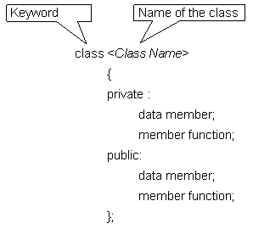
Class Declaration

Slide 66
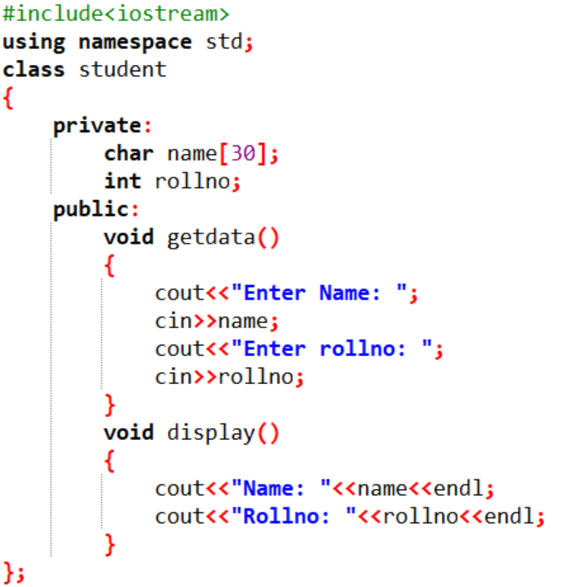

Slide 67
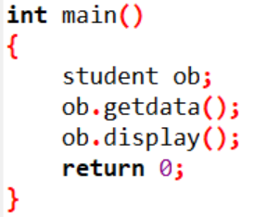

Slide 68
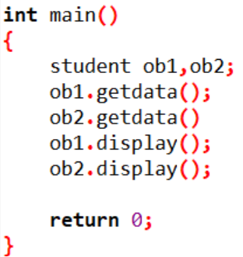

Slide 69
Scope resolution operator
Scope resolution operator (::) is used to define a function outside a class or when we want to use a global variable but also has a local variable with the same name.
Example:
#include <iostream>
using namespace std;
char c = 'a'; // global variable
int main() {
char c = 'b'; //local variable
cout << "Local variable: " << c << "\n";
cout << "Global variable: " << ::c << "\n"; //using scope resolution operator
return 0;
}

Slide 70
Methods definition
The member function of the class can be defined in two different ways:
Inside the class definition: The member functions are simple defined inside the class only i.e the body of the function resides inside the range of class only.
2) Outside the class definition: by using scope resolution operator, which specifies that the scope of the function is restricted to the class class_name.
Syntax:- class_name:: function_name

Slide 71
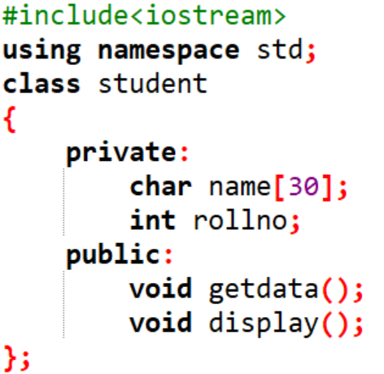
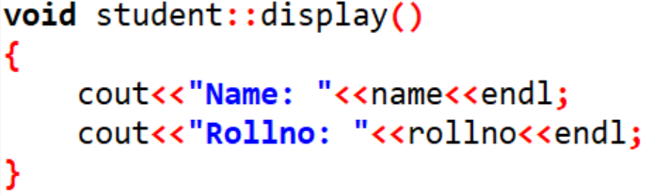
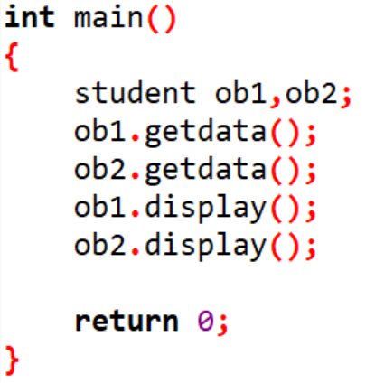
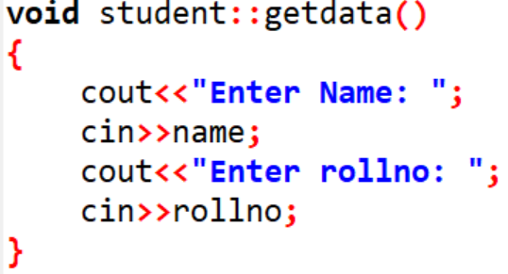

Slide 72
Inside the class definition
Eg: class abc
{
private:
int rollno;
char name[20];
public:
void getdata()
{
cout<<“name=“;
cin>>name;
cout<<“rollno=“;
cin>>rollno;
}
void display()
{
cout<<“name=“<<name;
cout<<“rollno=“<<rollno;
}
};

Slide 73
Outside the class definition
Example:
class abc
{
private:
int rollno;
char name[20];
public:
void getdata();
void display();
};
void abc :: getdata()
{
cout<<“name=“;
cin>>name;
cout<<“rollno=“;
cin>>rollno;
}
void abc :: display()
{
cout<<“name and rollno=“;
cout<<name<<rollno;
}

Slide 74

Example
#include<iostream>
using namespace std;
class item {
int number;
float cost;
public:
void getdata(int a, float b);
void putdata(void)
{
cout<<"number:"<<number<<"\n";
cout<<"cost:"<<cost<<"\n";
}
};
void item :: getdata(int a, float b)
{
number=a;
cost=b;
}
int main()
{
item x;
cout<<"\n object x"<<"\n";
x.getdata(100, 299.95);
x.putdata();
item y;
cout<<"\n object y"<<"\n";
y.getdata(200, 175.50);
y.putdata();
return 0;
}
Output:

Slide 75
MCQ
What does your class can hold?
A. data
B. functions
C. both a & b
D. none of the mentioned

Slide 76
Solution
What does your class can hold?
A. data
B. functions
C. both a & b
D. none of the mentioned

Slide 77


Slide 78
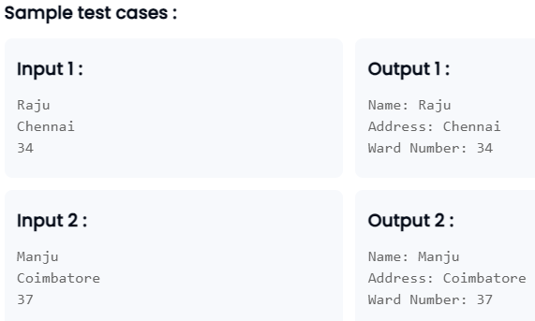

Slide 79
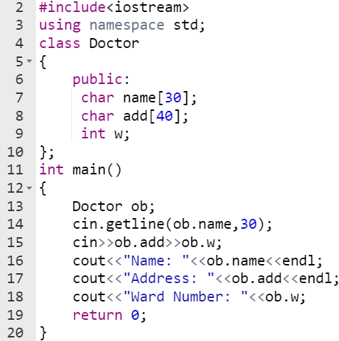

Slide 80
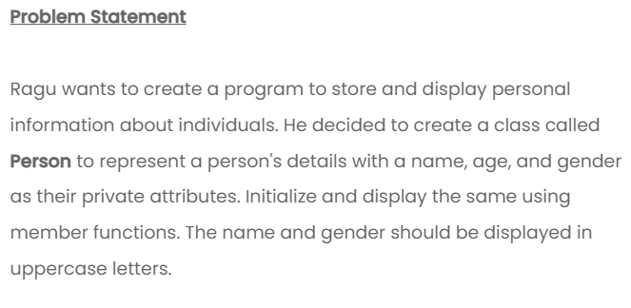

Slide 81
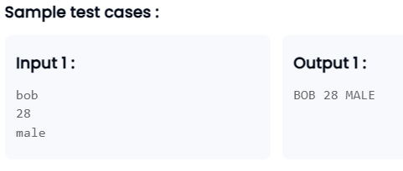

Slide 82
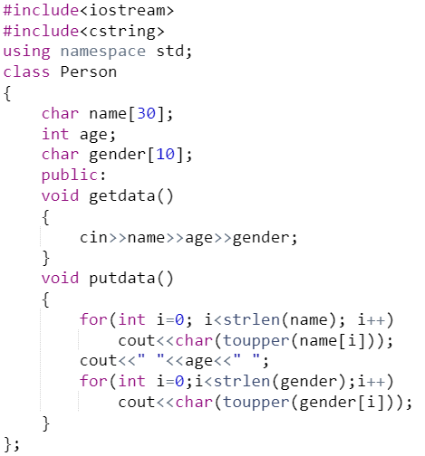
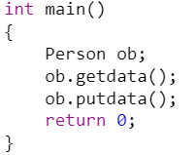

Slide 86
Creating class objects
Once a class has been declared, we can create variables of that type by using the class name.
For example:
item x;
Creates a variable x of type item. In C++, the class variables are known as objects. Therefore, x is called an object of item. We may also declare more than one object in one statement. Example:
item x,y,z;
The declaration of an object is similar to that of a variable of any basic type. The necessary memory space is allocated to an object at this stage.

Slide 87
Creating class objects
Objects can also be created when a class is defined by placing their names immediately after the closing brace, as we do in the case of structures. For example:
class item
{
….……
….……
} x,y,z;
Would create the objects x,y and z of type item. This practice is seldom followed because we would like to declare the objects close to the place where they are used and not at the time of class definition.

Slide 88
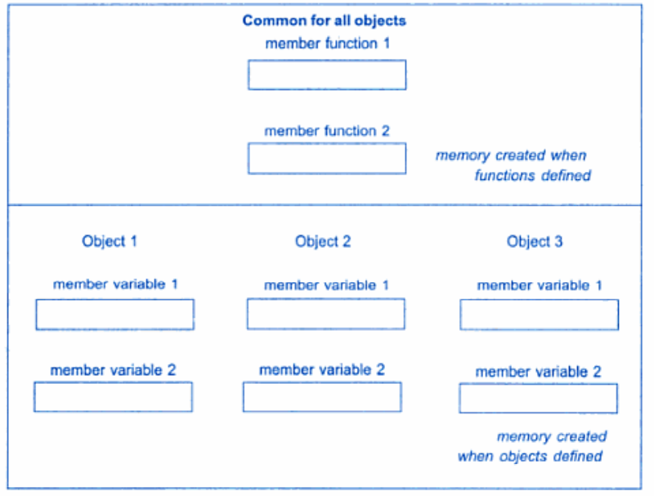
More points
Size of the empty class in C++ is 1 byte(Reason: Unique address identification for objects)
Memory allocation for objects:

Slide 89
Memory allocation for objects
Actually, the member functions are created and placed in the memory space only once when they are defined as a part of a class specification.
Since all the objects belonging to that class use the same member functions, no separate space is allocated for member functions when the objects are created.
Only space for member variables is allocated separately for each object.
Separate memory locations for the objects are essential, because the member variables will hold different data values for different objects.

Slide 90
Accessing a Data Member
Accessing a data member depends solely on the access control of that data member. If its public, then the data member can be easily accessed using the direct member access (.) operator with the object of that class.
class A
{
public:
int x;
Void func();
}obj1;
main()
{
A obj2;
obj1.x=10;
obj2.x=20;
obj1.func();
---
}
Access Specifier : will discuss in the next slide
1st Method to declare object
2nd Method to declare object
Obj_name.Var1
Obj_name.function()
Accessing data members using obj

Slide 91
Access specifiers
There are 3 access specifiers for a class in C++.
These access specifiers define how the members of the class can be accessed.
Of course, any member of a class is accessible within that class. There are three types of access specifiers, they are:
Public
Private
Protected

Slide 92
Public
Any member declared under this specifier is accessible from outside the class, by using the object of the class. The public members of a class get inherited completely to the child classes.
Syntax:
class definition
{
public :
declarations or definitions
} ;

Slide 93
Example
#include<iostream>
using namespace std;
class A
{
public:
int a;
};
int main()
{
A ob1;
ob1.a=10;
cout<<ob1.a<<"\n";
}

Slide 94
Private
Any member declared under this specifier is Not Accessible from Outside the Class. The Private members are accessible to only the Member Functions and Friend Functions in the class. The Private members of a Class Never get Inherited to the Child Classes.
Syntax:
class definition
{
private :
declarations or definitions
} ;

Slide 95
Example
#include<iostream>
using namespace std;
class A
{ private :
int a;
public :
void fill ( )
{ cin >> a ;
cout<<a;
}
} ;
main()
{ int c;
A oba ;
// oba . a = 10 ; // invalid as ‘ a ‘ is private member.
oba . fill ( ) ; // valid as fill ( ) is a public member.
}

Slide 96
Protected
Any member declared under this specifier is not accessible from outside the class, by using the object of the class.
The protected members of a class get inherited completely to the child classes and they maintain their protected visibility in the child class.
The protected members are accessible to only the member functions and friend functions in the class.
Syntax:
Class definition
{
protected :
declarations or definitions
} ;
Example will discuss after MTT

Slide 97
Area of a circle
// C++ program to demonstrate public
// access modifier
#include <iostream>
using namespace std;
// class definition
class Circle {
public:
double radius;
double compute_area()
{
return 3.14 * radius * radius;
}
};
int main()
{
Circle obj;
// accessing public data member outside class
obj.radius = 5.5;
cout << "Radius is: " << obj.radius << "\n";
cout << "Area is: " << obj.compute_area();
return 0;
}
// C++ program to demonstrate private
// access modifier
#include <iostream>
using namespace std;
class Circle {
private:
double radius;
public:
void compute_area(double r)
{
radius = r;
double area = 3.14 * radius * radius;
cout << "Radius is: " << radius << endl;
cout << "Area is: " << area;
}
};
int main()
{
Circle obj;
obj.radius = 5.5;
// Error trying to access private data member
// directly outside the class
obj.compute_area(1.5);
return 0;
}

Slide 98
MCQ
The default access level assigned to members of a class is ___________
a)Private
b)Public
c)Protected
d)Needs to be assigned

Slide 99
Solution
The default access level assigned to members of a class is ___________
a)Private
b)Public
c)Protected
d)Needs to be assigned

Slide 100
MCQ
We cannot use __________ members outside the class
a. Public
b. private
c. Protected
d. Local

Slide 101
Solution
We cannot use __________ members outside the class
a. Public
b. private
c. Protected
d. Local

Slide 102
Public Vs. Private
PUBLIC | PRIVATE
All the class members declared under public will be available to everyone. | The class members declared as private can be accessed only by the functions inside the class.
The data members and member functions declared public can be accessed by other classes too. | Only the member functions or the friend functions are allowed to access the private data members of a class.
The public members of a class can be accessed from anywhere in the program using the direct member access operator (.) with the object of that class. | They are not allowed to be accessed directly by any object or function outside the class.
will discuss it later

Slide 103
MCQ
Find output:
class Circle {
int radius;
float compute_area()
{
radius=1;
return 3.14 * radius * radius;
}
};
int main()
{
Circle obj;
cout << "Area is: " << obj.compute_area();
return 0;
}
a: 3.140000
b: 3.14
c: no output
d: error

Slide 104
Solution
Find output:
class Circle {
int radius;
float compute_area()
{
radius=1;
return 3.14 * radius * radius;
}
};
int main()
{
Circle obj;
cout << "Area is: " << obj.compute_area();
return 0;
}
a: 3.140000
b: 3.14
c: no output
d: error
Note: Pvt. member can’t access outside the class

Slide 105
Program 1: Basic_class_object
void sum()
{
int z;
z=x+y;
cout<<"The sum is:"<<z;
}
};
int main()
{
abc obj1;
obj1.getdata();
obj1.sum();
}
#include<iostream>
using namespace std;
class abc
{
int x,y;
public:
void getdata()
{
cout<<"Enter the values of x and y:"<<endl;
cin>>x>>y;
}

Slide 106
Program 2: Basic_class_object
#include<iostream>
using namespace std;
class item
{
int number;
float cost;
public:
void getdata(int a,float b)
{
number=a;
cost=b;
}
//Defining member function inside class definition
void putdata(void)
{
cout<<"Number:"<<number<<"\n";
cout<<"Cost:"<<cost<<"\n";
}
};
int main()
{
item x;
cout<<"\nObject x="<<"\n";
x.getdata(100,299.95);
x.putdata();
item y;
cout<<"\nobject y="<<"\n";
y.getdata(200,175.50);
y.putdata();
return 0;
}

Slide 107
Program 3: Arithmetic operations using class
#include<iostream>
using namespace std;
class arithmetic
{
int x,y;
public:
void getdata()
{
cout<<"Enter the value of x and y:"<<endl;
cin>>x>>y;
}
void sum()
{
int z;
z=x+y;
cout<<"Sum is:"<<z;
}
void divide()
{
int z;
z=x/y;
cout<<"Division is:"<<z;
}
void multiply()
{
int z;
z=x*y;
cout<<"Multiplication is:"<<z;
}
void subtract()
{
int z;
z=x-y;
cout<<"Subtraction result is:"<<z;
}
};

Slide 108
Program 3: Arithmetic operations using class
int main()
{
arithmetic obj1;
obj1.getdata();
obj1.sum();
obj1.subtract();
obj1.multiply();
obj1.divide();
}

Slide 109
Program 4:
Array of objects
#include<iostream>
#include<conio.h>
using namespace std;
class employee
{
char name[50];
int age;
public:
void getdata(void);
void putdata(void);
};
void employee::getdata(void)
{
cout<<"\n Enter the name of employee:";
cin>>name;
cout<<"\n Enter the age of employee:";
cin>>age;
}
void employee::putdata(void)
{
cout<<"\n Entered name is:"<<name;
cout<<"\n Entered age is:"<<age;
}

Slide 110
Program 4:
Array of objects
const int size=3;
int main()
{
employee emp[size];
int i;
for(i=0;i<3;i++)
{
cout<<"\n Enter details of employee number"<<i+1;
emp[i].getdata();
}
for(i=0;i<3;i++)
{
cout<<"\nDetails of the employee number"<<i+1;
emp[i].putdata();
}
getch();
return 0;
}

Slide 111
C++ practicing examples
Class to represent the details of a student
Class to represent the details of two students
Class to represent the ‘n’ student details.

